Slide 1
MATHEMATICAL MODELING OF CELL-FREE PROTEIN SYNTHESIS
Presented By: M.A.A. Aqeel
Supervised By: Dr. S.P. Rajapaksha
University of Sri Jayewardenepura

Slide 2
INTRODUCTION

Slide 3
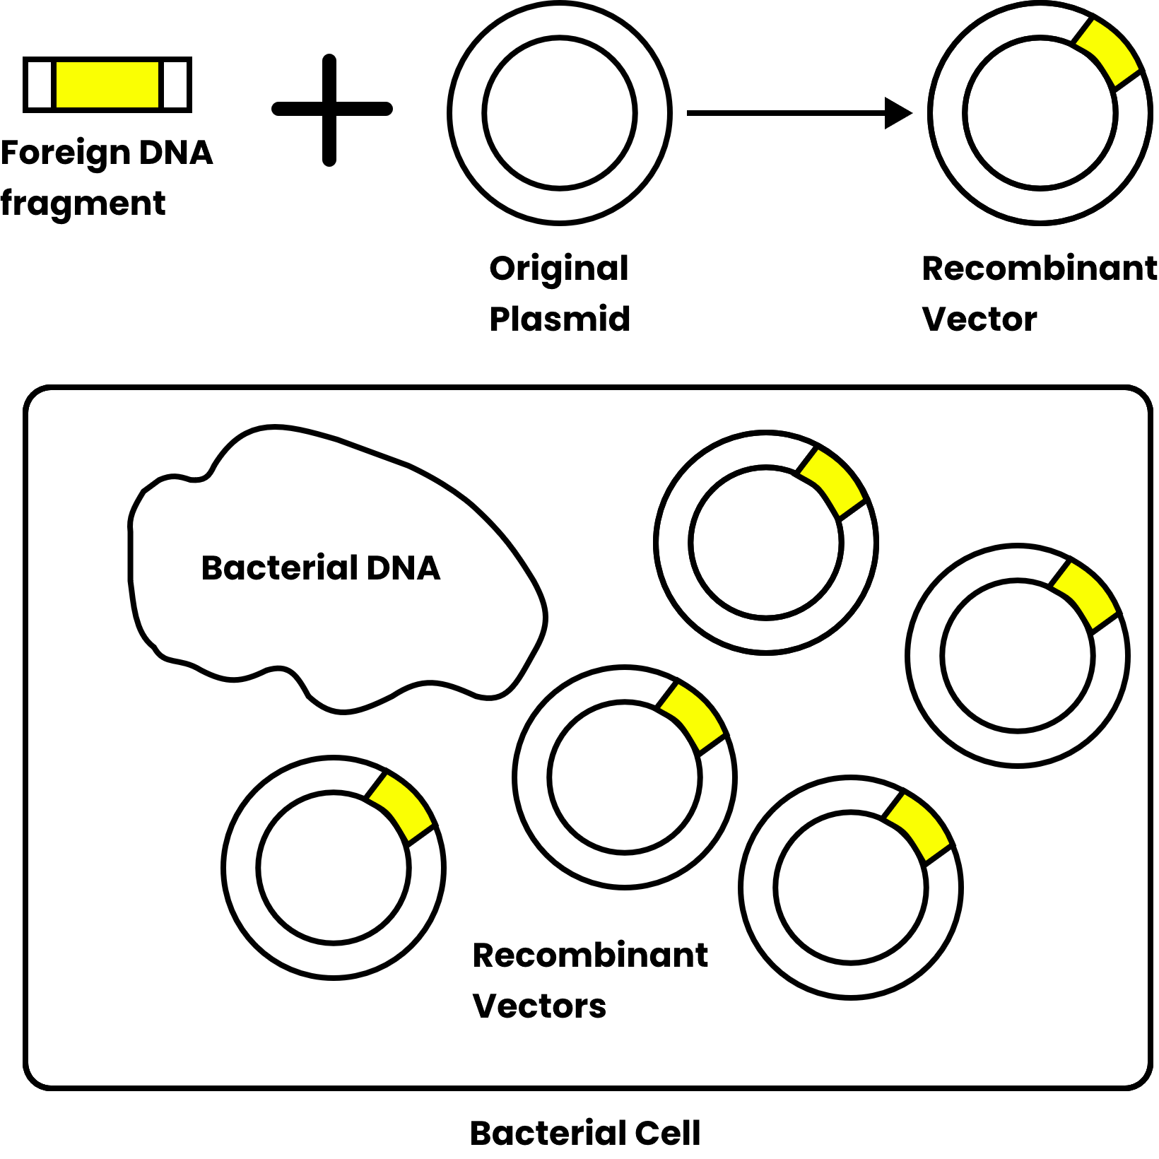
INTRODUCTION TO CELL-FREE PROTEIN SYNTHESIS
Genetic Engineering
Most therapeutic proteins are difficult to manufacture with available synthetic capabilities
Microbial cultures can be utilized through genetic engineering to produce such complex molecules
However, the product yield will be changed according to the nutritional and environmental conditions confronted by cells/culture

Slide 4
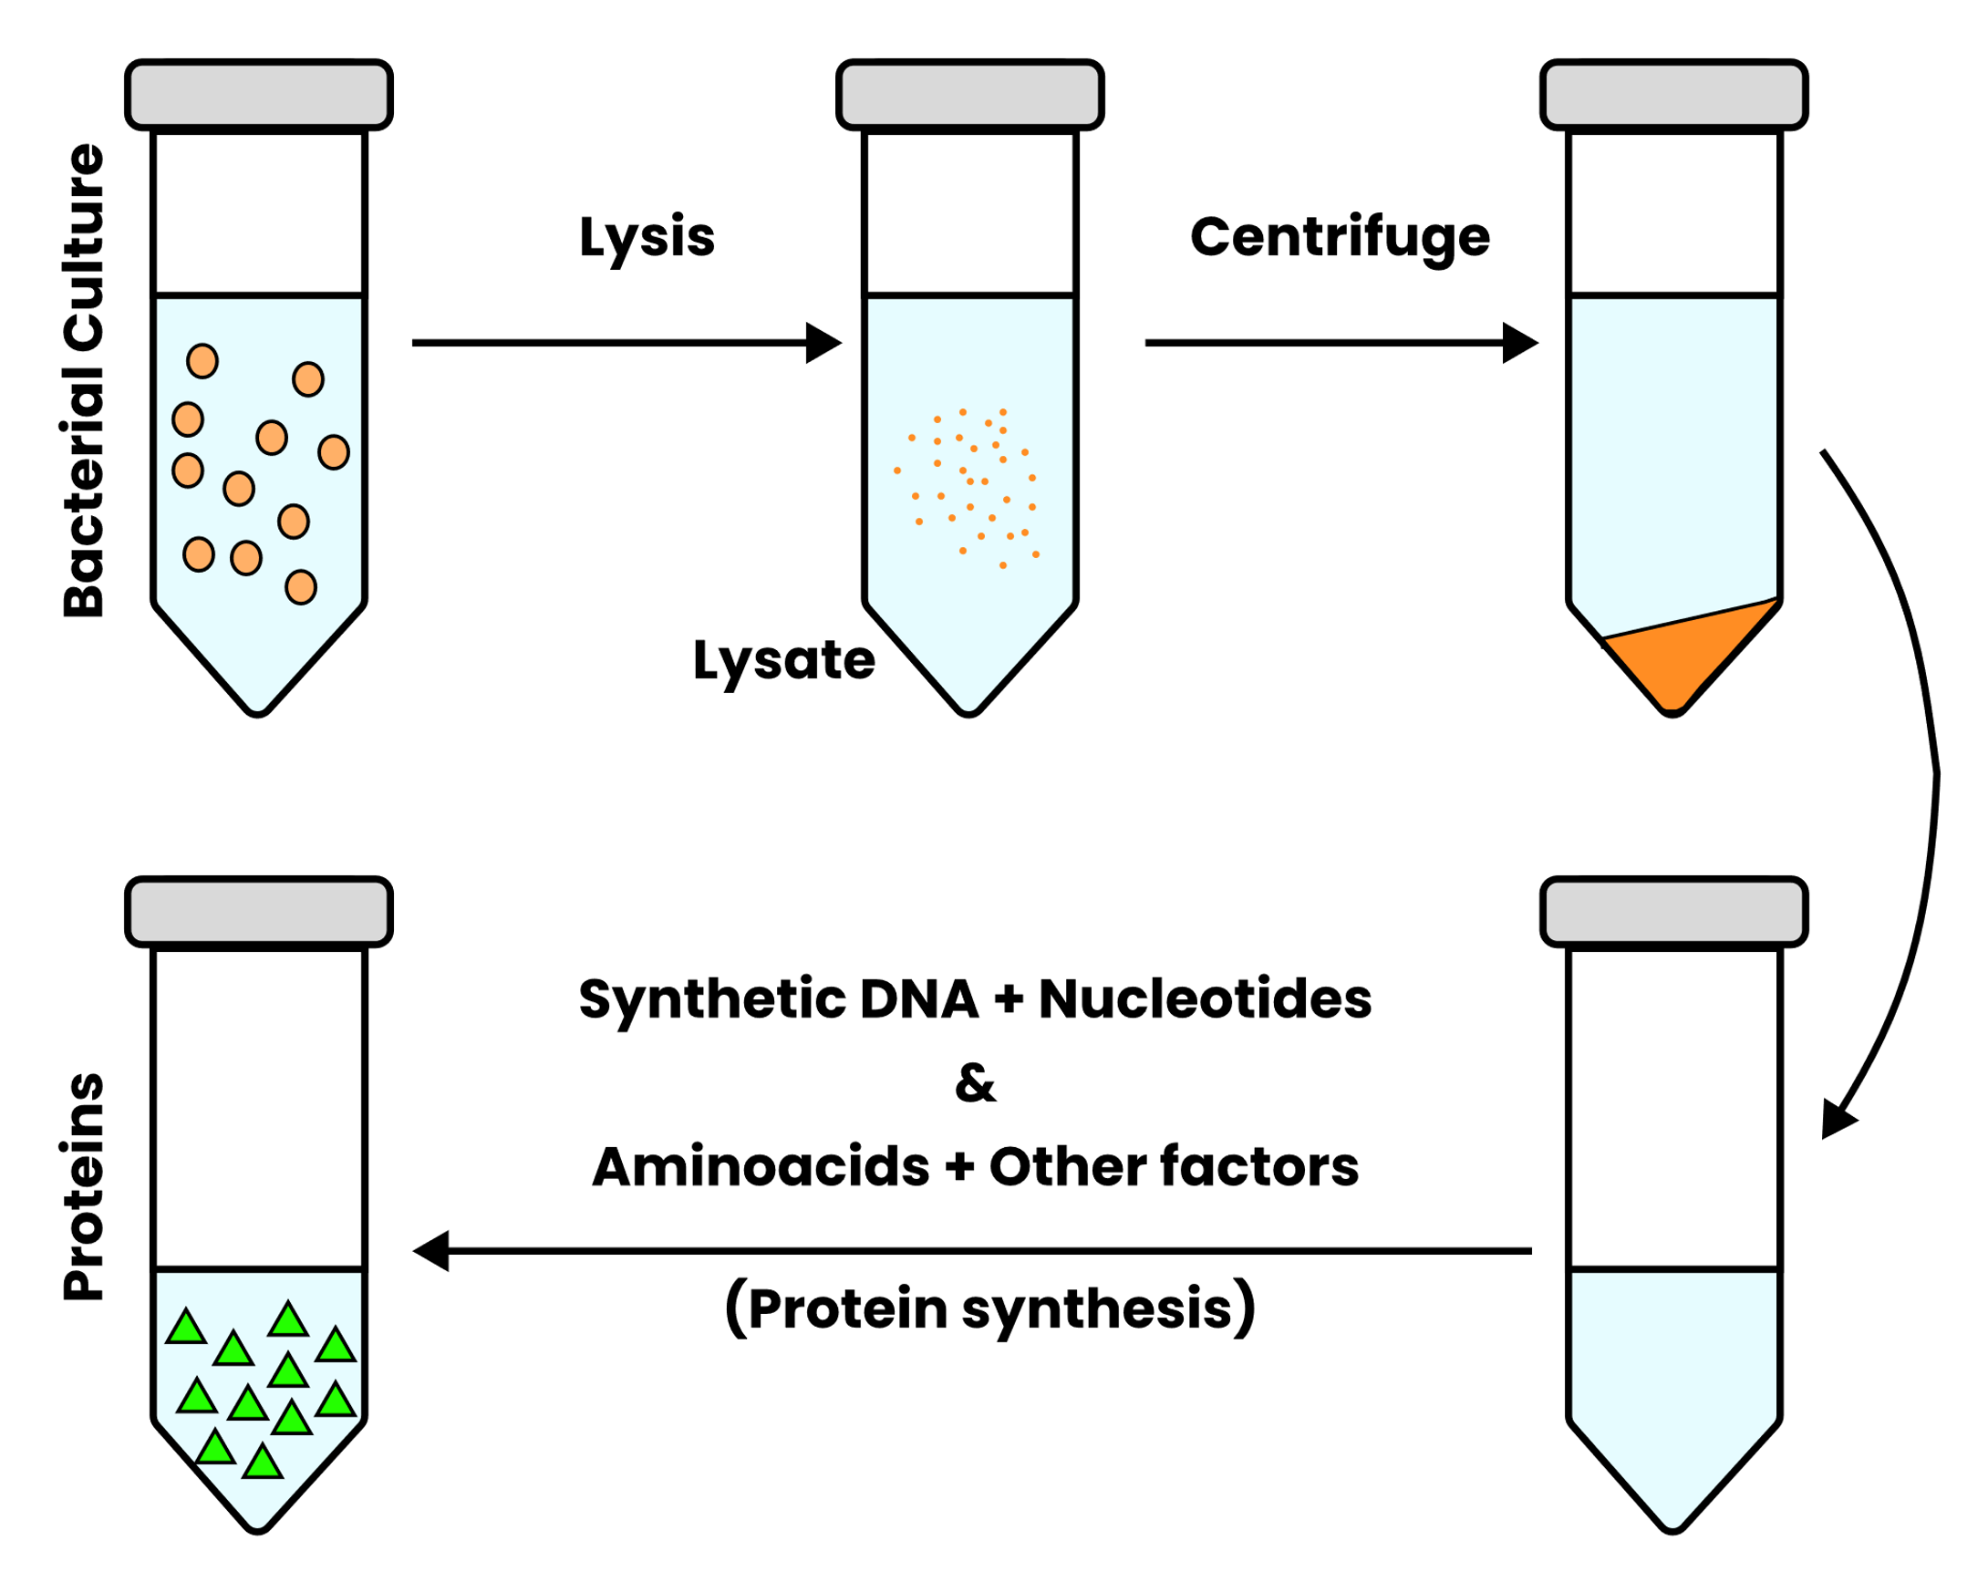
INTRODUCTION TO CELL-FREE PROTEIN SYNTHESIS
Cell-free protein synthesis (CFPS)
Extracting and assembling the necessary molecular components of protein synthesis into a vessel can avoid confounding results associated with cell-based systems
Executing DNA programs in a cell-free format can open new avenues for biomanufacturing and metabolic engineering

Slide 5
INTRODUCTION TO CELL-FREE PROTEIN SYNTHESIS
Applications of CFPS Monoclonal antibody production Vaccines Analyzing metabolic and genetic disorders Synthesis of non-canonical proteins Synthesis of niche drugs Membrane proteins Prototyping metabolic circuits Antimicrobial peptides | Limitations of CFPS Cost of synthesizing desired DNA template Resource exhaustion Inherent ribonuclease and protease activity Short active duration Small batch size

Slide 6
OBJECTIVES
General Objective
To develop a minimalistic mathematical model that grasps the basic mechanics of protein synthesis in CFPS systems
Specific Objectives
To understand the CFPS system towards DNA template loading capacity
To understand the model behavior towards the consumption of biological nutrients
To check the influence of inherent factors of the extract on active duration
To provide better designs for CFPS Design-Build-Test-Learn (CFPS-DBTL) workflow

Slide 7
MODEL DEVELOPMENT

Slide 8
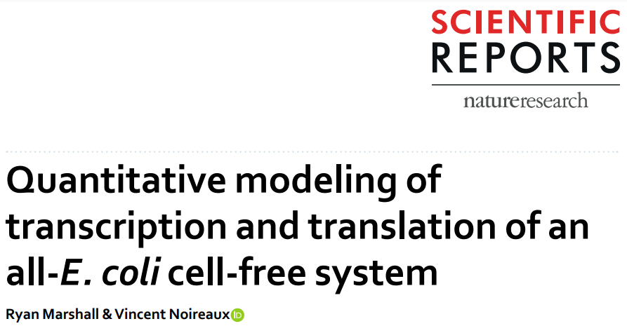
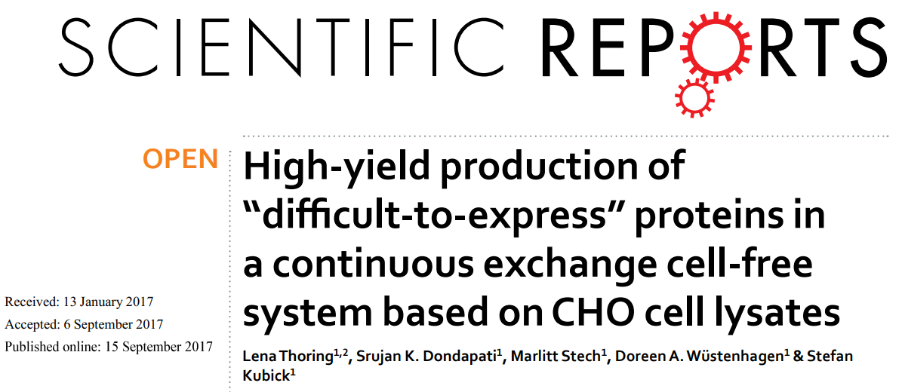
MODEL DEVELOPMENT
STEP 1
Literature survey on cell-free protein synthesis

Slide 9
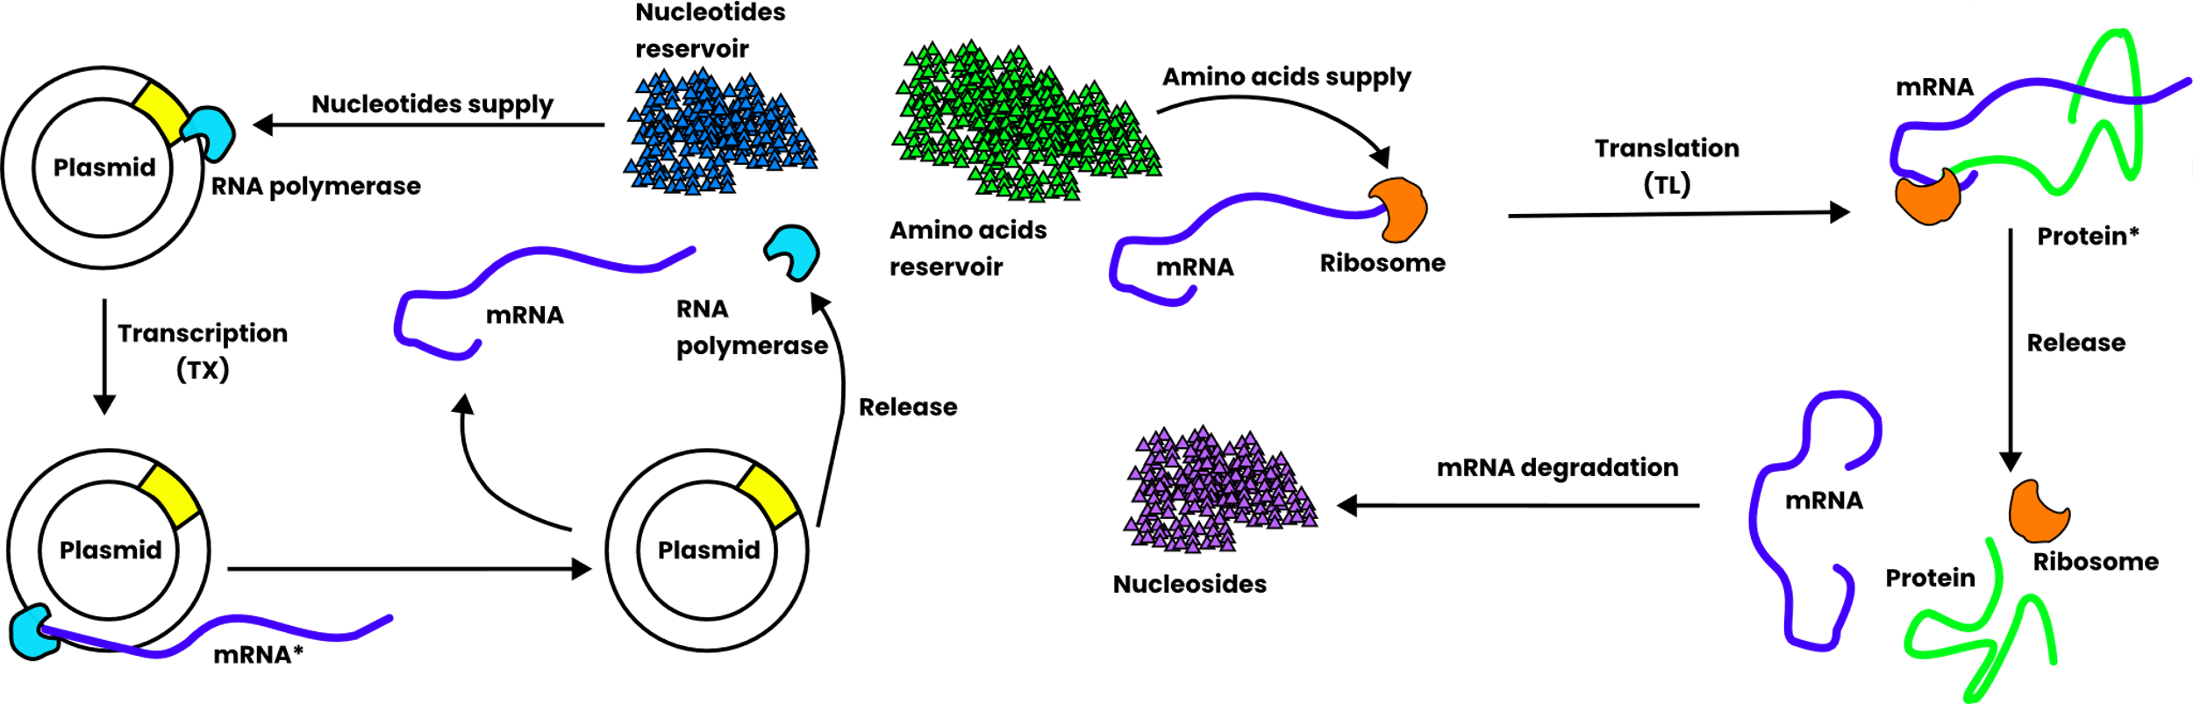
MODEL DEVELOPMENT
STEP 2
Identify the minimal molecular components required for protein synthesis

Slide 10
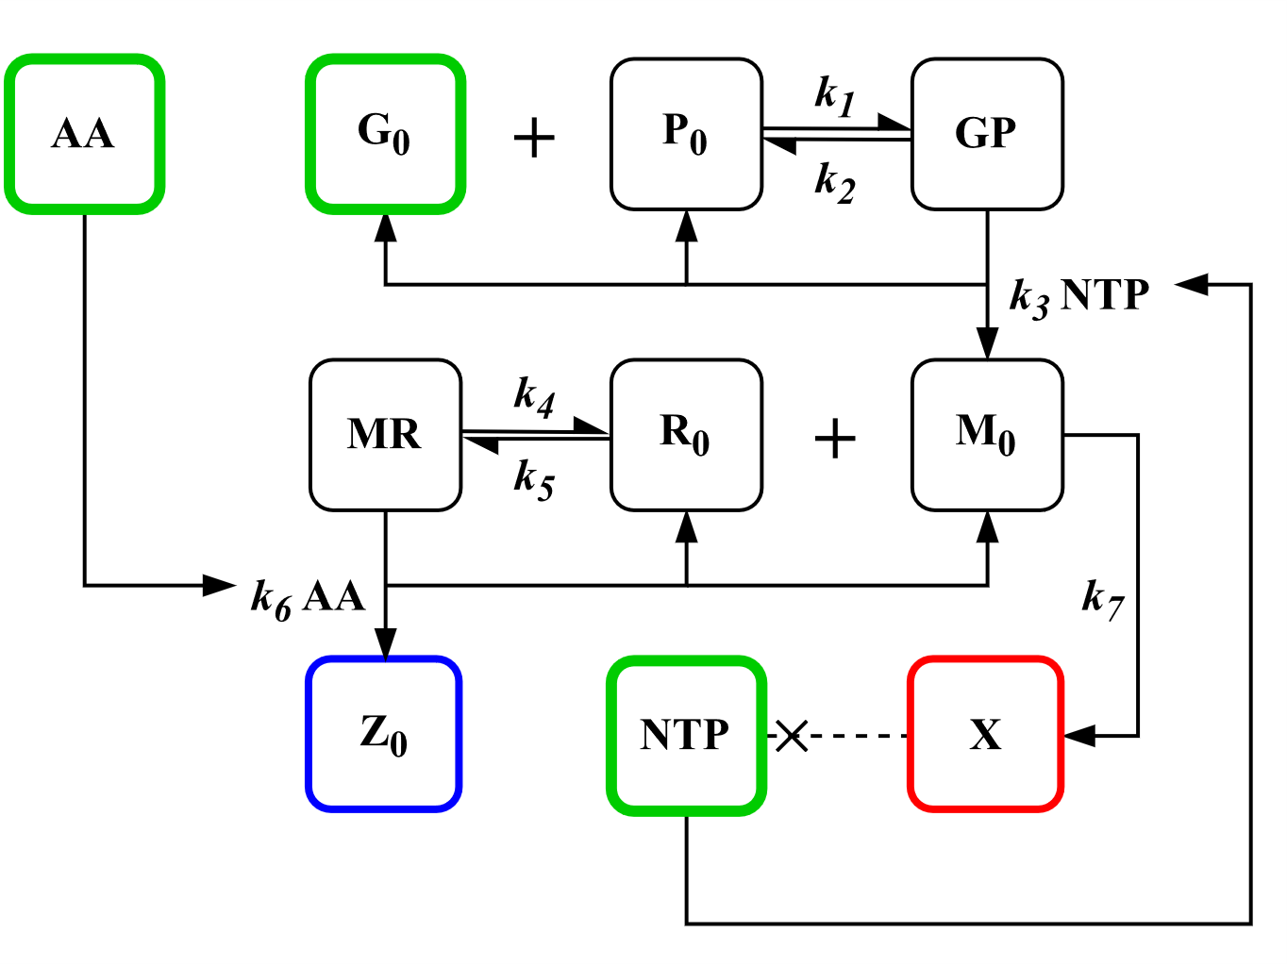
MODEL DEVELOPMENT
STEP 3
Construct the chemical reaction network based on literature findings
G₀ – plasmid
P₀ – RNA polymerase (RNAP)
GP – RNAP-plasmid complex
M₀ – mRNA
R₀ – ribosome
MR – mRNA-ribosome complex NTP – nucleotide reservoir
AA – amino acids reservoir
Z₀ – reporter protein
k1 – RNAP-promoter association
k2 – RNAP-promoter dissociation
k3 – mRNA production
k4 – mRNA-ribosome association
k5 – mRNA-ribosome dissociation
k6 – protein production
k7 – mRNA degradation

Slide 11
MODEL DEVELOPMENT
STEP 4
Develop mass action-based equations for each molecular component
Differential Equations
[G₀] = – k₁[G₀][P₀] + k₂[GP] + k₃[NTP][GP]
[P₀] = – k₁[G₀][P₀] + k₂[GP] + k₃[NTP][GP]
[GP] = k₁[G₀][P₀] – k₂[GP] – k₃[NTP][GP]
[M₀] = k₃[NTP][GP] – k_{m}[M₀] – k₄[M₀][R₀] + k₅[MR] + k₆[AA][MR]
[R₀] = –k₄[M₀][R₀] + k₅[MR] + k₆[AA][MR]
[MR] = k₄[M₀][R₀] – k₅[MR] – k₆[AA][MR]
[NTP] = – k₃[NTP][GP] | [Ġ]
[AA] = – k₆[AA][MR] | [Z₀] = k₆[AA][MR]

Slide 12
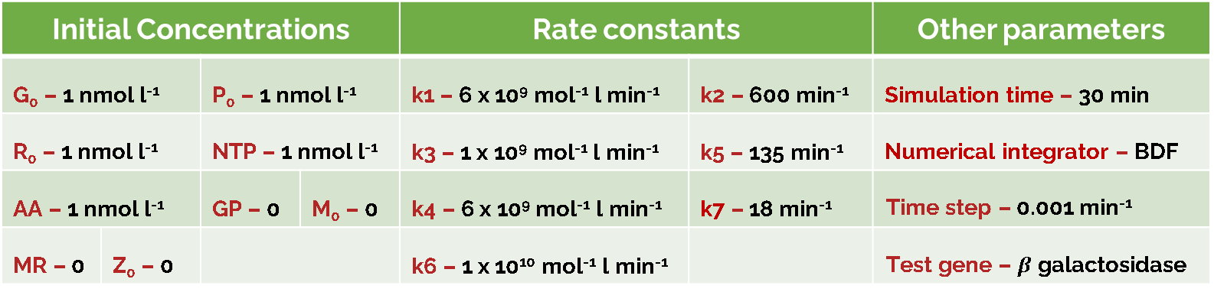
MODEL DEVELOPMENT
STEP 5
Carry out simulation for a collection of time points using a computational software (R and the package deSolve)
Initial Concentrations |  |  |  | Rate constants |  | Other parameters
G₀ – 1 nmol l⁻¹ |  | P₀ – 1 nmol l⁻¹ |  | k1 – 6 x 10⁹ mol⁻¹ l min⁻¹ | k2 – 600 min⁻¹ | Simulation time – 30 min
R₀ – 1 nmol l⁻¹ |  | NTP – 1 nmol l⁻¹ |  | k3 – 1 x 10⁹ mol⁻¹ l min⁻¹ | k5 – 135 min⁻¹ | Numerical integrator – BDF
AA – 1 nmol l⁻¹ |  | GP – 0 | M₀ – 0 | k4 – 6 x 10⁹ mol⁻¹ l min⁻¹ | k7 – 18 min⁻¹ | Time step – 0.001 min⁻¹
MR – 0 | Z₀ – 0 |  | Z₀ – 0 | k6 – 1 x 10¹⁰ mol⁻¹ l min⁻¹ |  | Test gene – $β$ galactosidase
Code Availability
https://github.com/zachariah-ibrahim/cell-free-protein-expression
Parameter availability
Kierzek, A. M., Zaim, J., & Zielenkiewicz, P. (2001). The effect of transcription and translation initiation frequencies on the stochastic fluctuations in prokaryotic gene expression. The Journal of Biological Chemistry, 276(11), 8165–8172. doi:10.1074/jbc.M006264200

Slide 13
RESULTS & DISCUSSION

Slide 14
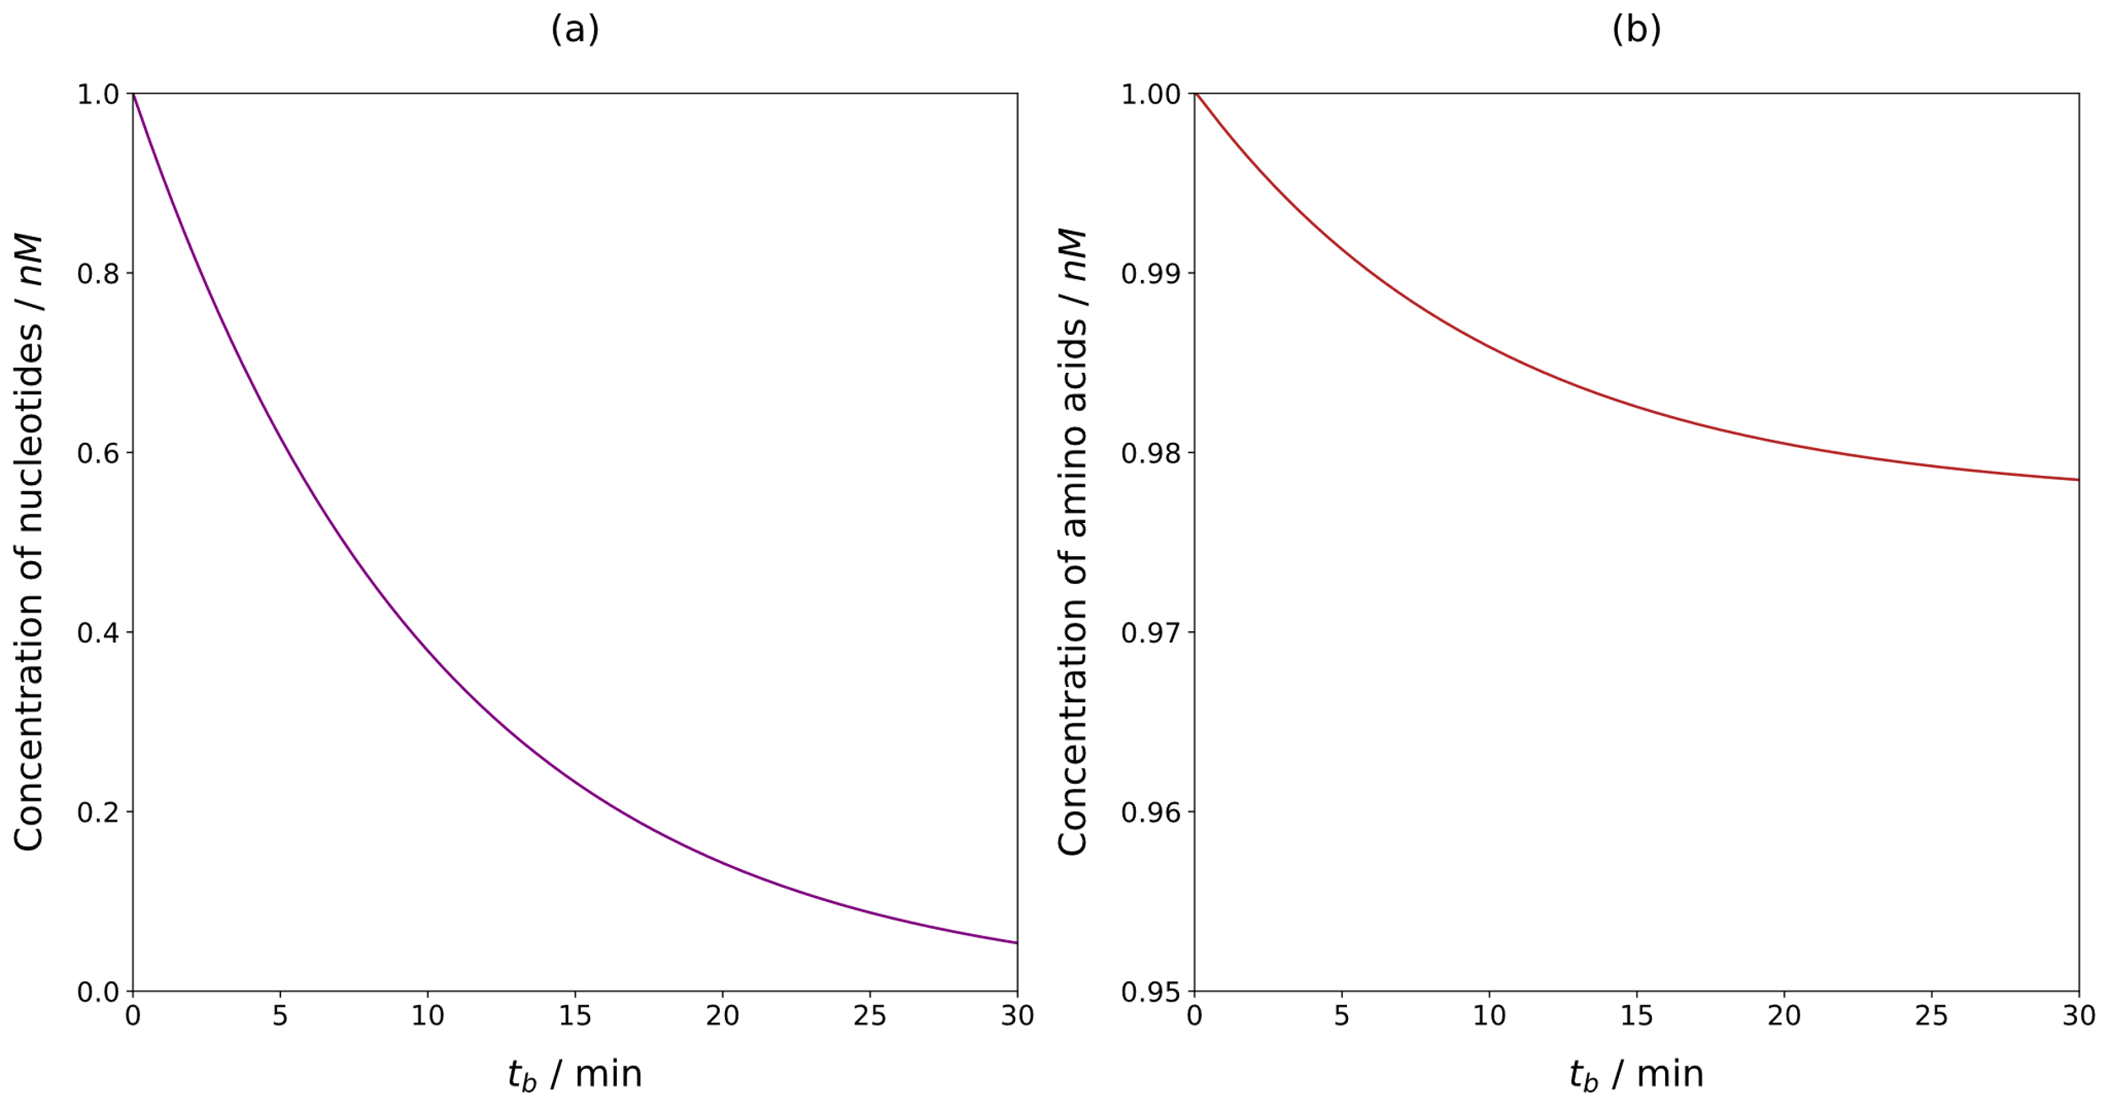
RESULTS & DISCUSSION
The consumption of NTP is do not correlate with mRNA production
In contrast, the amino acids consumption correlate with protein production

Slide 15
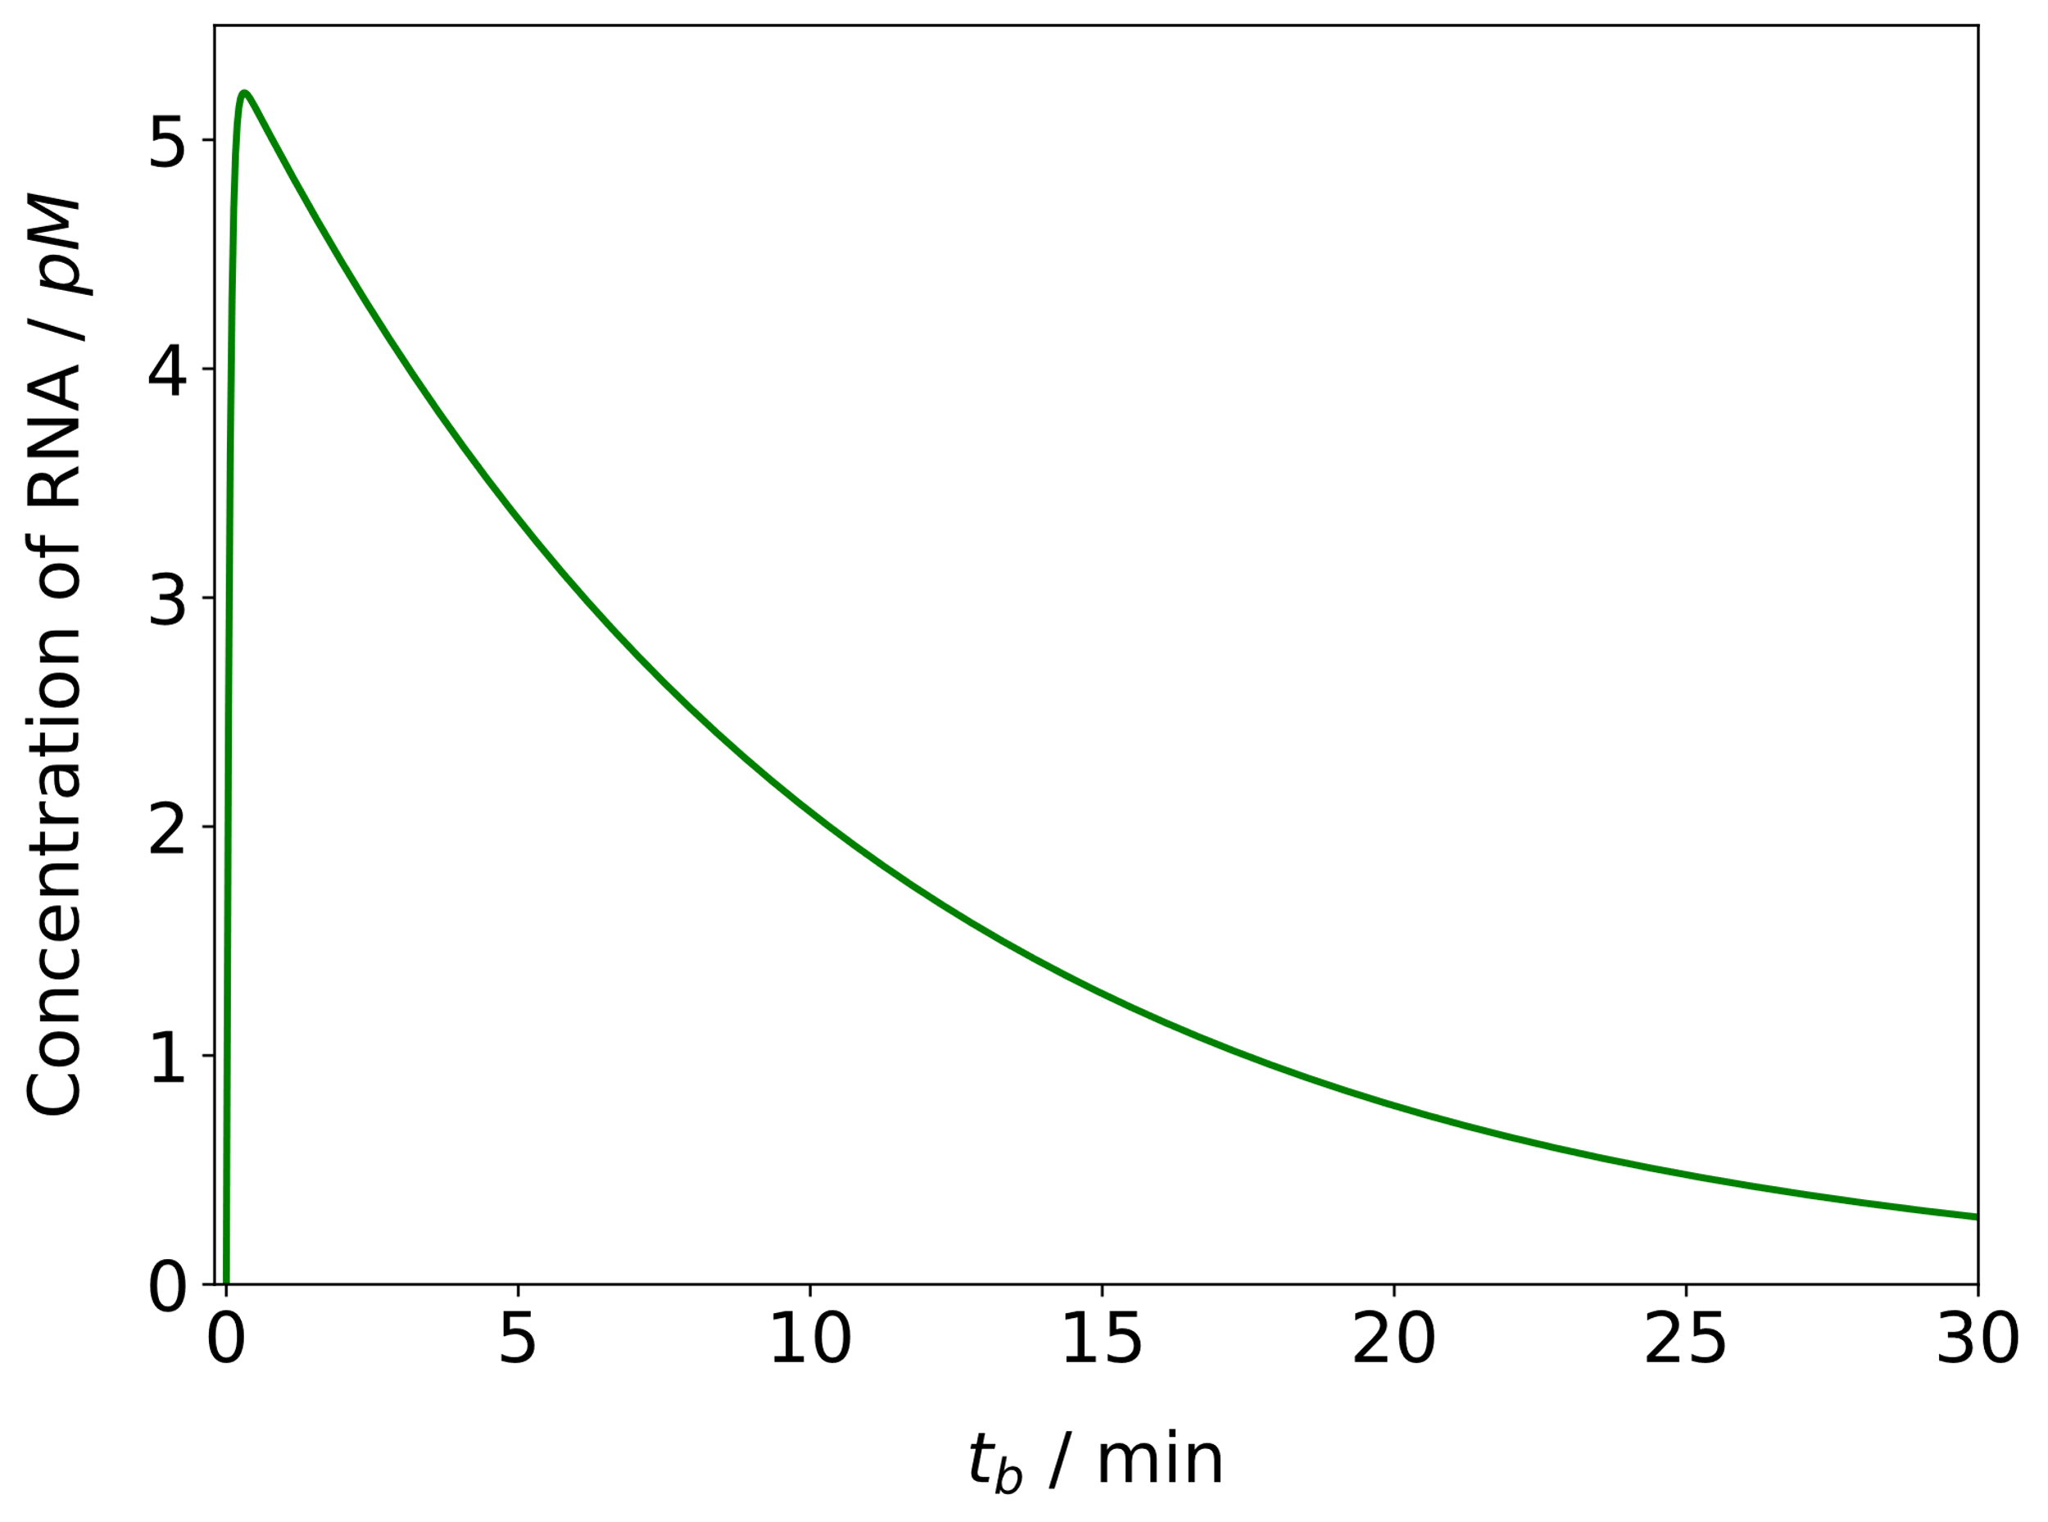
RESULTS & DISCUSSION
The mRNA concentration goes through a maxima and decays exponentially

Slide 16
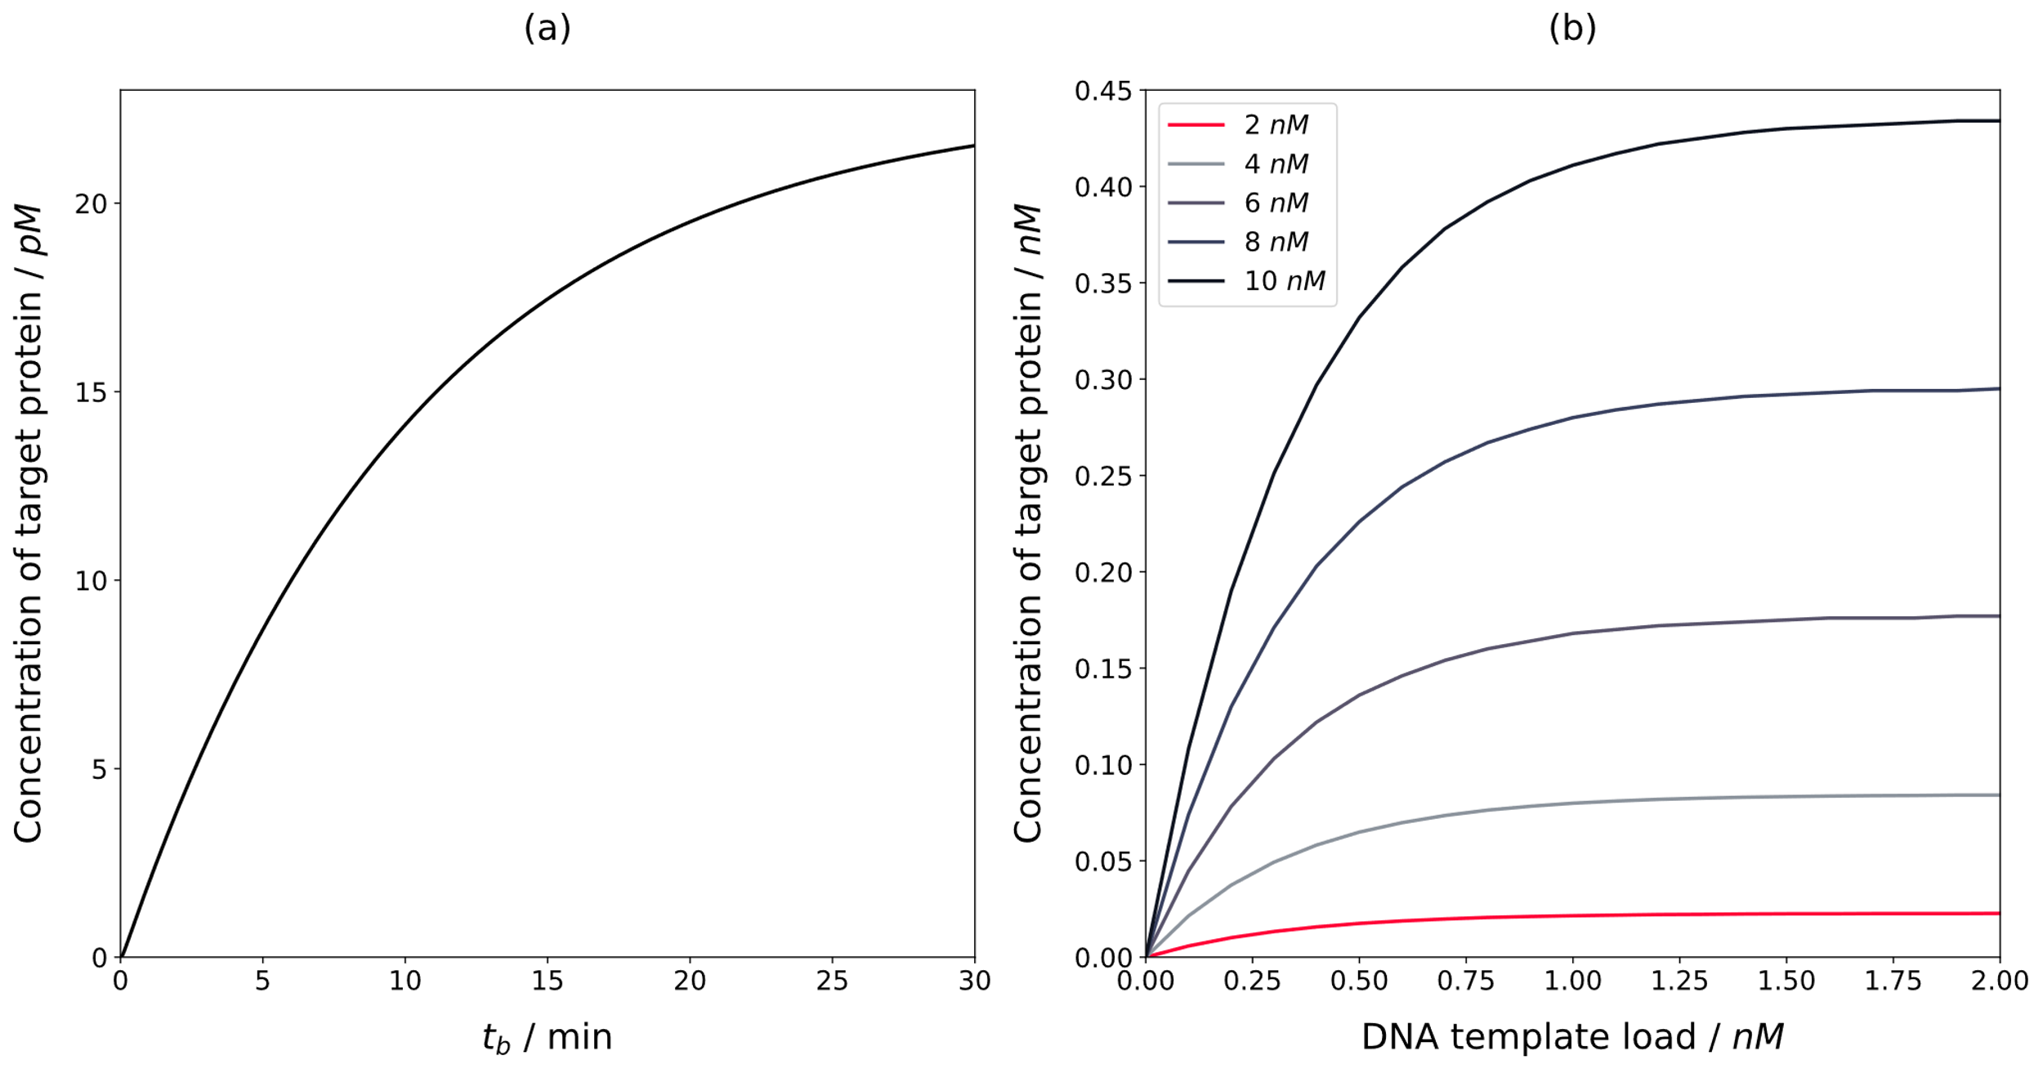
RESULTS & DISCUSSION
For the reaction time of 30 min, the maximum concentration of reporter protein that can be obtained is 21 pM
Increasing the biochemical resources available to CFPS system can increase the protein yield from 21 pM to 0.4 nM

Slide 17
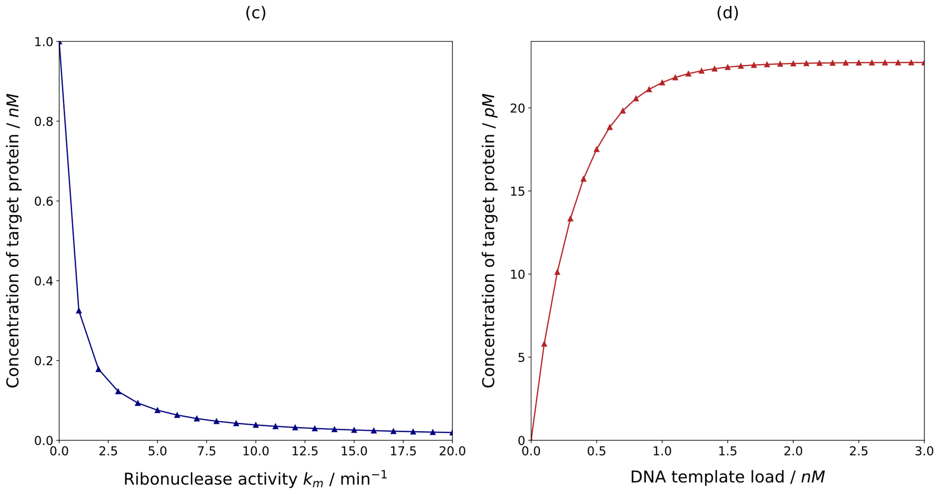
RESULTS & DISCUSSION
Suppressing the ribonuclease activity can improve the target protein yield significantly
The DNA loading indicates that the yield increases linearly and plateaus after a critical DNA concentration of 2.0 nM

Slide 18
CONCLUSION
The CFPS system require constant supply of resources to perpetuate
Inheriting detrimental components during extract preparation affects the performance of CFPS systems
In the absence of detrimental activities, protein yield increases proportionally with the resources supplied
The simulation studies will be useful for the communities that are involved in gene circuit engineering and biomanufacturing

Slide 19
REFERENCES
R Core Team. R: A Language and Environment for Statistical Computing; 2021.
Soetaert, K.; Petzoldt, T.; Setzer, R. W. Solving Differential Equations in R: Package deSolve. Journal of Statistical Software 2010, 33 (9), 1 - 25.
Ingalls, B. P.; ProQuest. Mathematical modeling in systems biology : an introduction; MIT Press, 2013.
Tinafar, A.; Jaenes, K.; Pardee, K. Synthetic Biology Goes Cell-Free. BMC Biol. 2019, 17 (1), 64.
Brown, T. A.; ProQuest. Gene cloning and DNA analysis : an introduction; Wiley Blackwell, 2016.

Slide 20
THANK YOU

